Slide 1
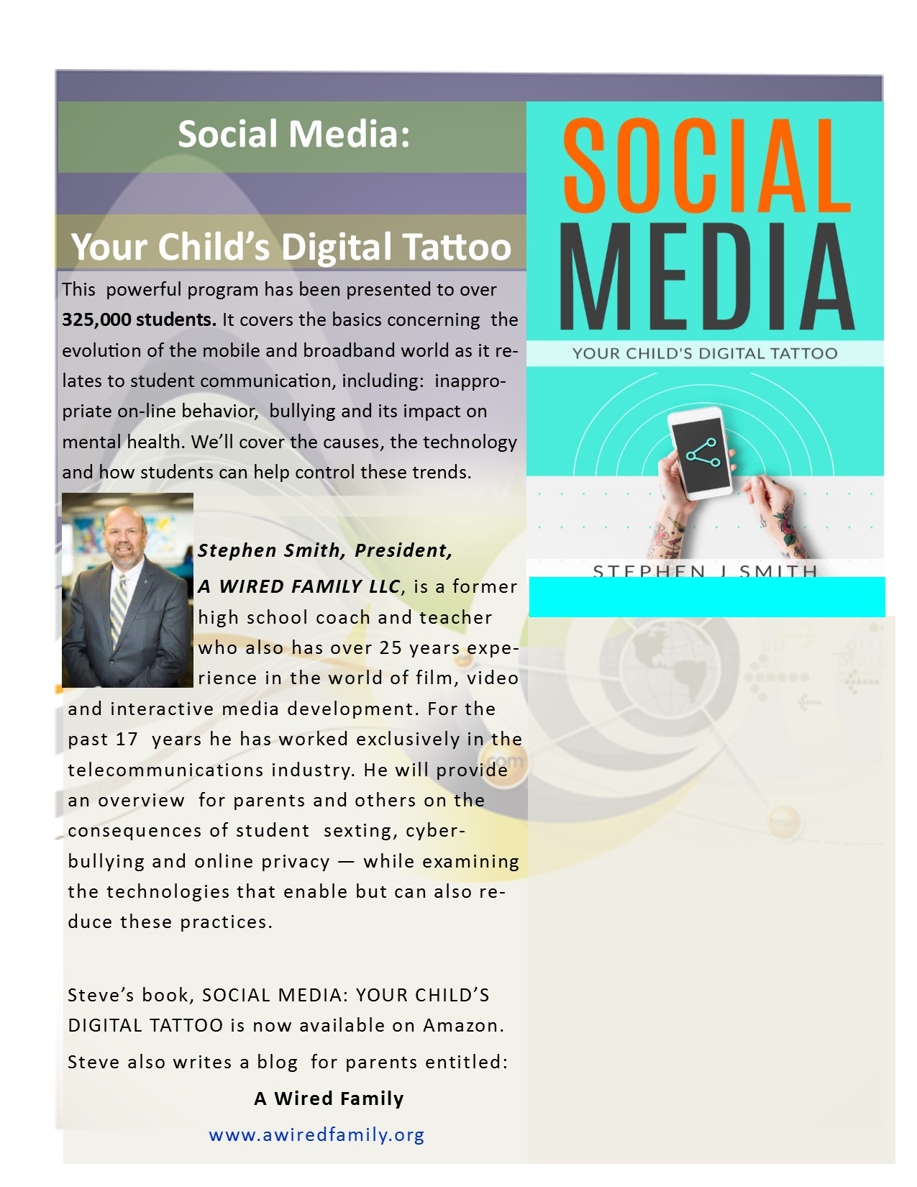
WC Connects
Parent Education Series
Monday, April 1st
6:30-8:00 PM
West Clermont Middle School
Performing Arts Center
For more information, call:
947-7621

